Slide 1
INVOICE MANAGEMENT SYSTEM

Slide 2
TABLE OF CONTENTS
INTRODUCTION
OBJECTIVE
SYSTEM DESIGN
Architecture overview
USER INTERFACE
Future Scope
conclusion

Slide 3

INTRODUCTION
An invoice management system is a software solution designed to automate the process of creating, sending, and managing invoices.
Crucial for maintaining healthy cash flow by ensuring timely invoicing and payment. Improves vendor relationships by providing transparent and efficient invoicing processes.
Improved cash flow management, increased efficiency and productivity, reduced errors and disputes.

Slide 4

OBJECTIVES
Streamlining Invoice Generation
Optimizing Product Tracking
Ensuring Reliability and Scalability
Enhancing User Experience
Enhancing Customer Management
Improving Workflow Efficiency
Facilitating Data Accessibility and Analysis

Slide 5
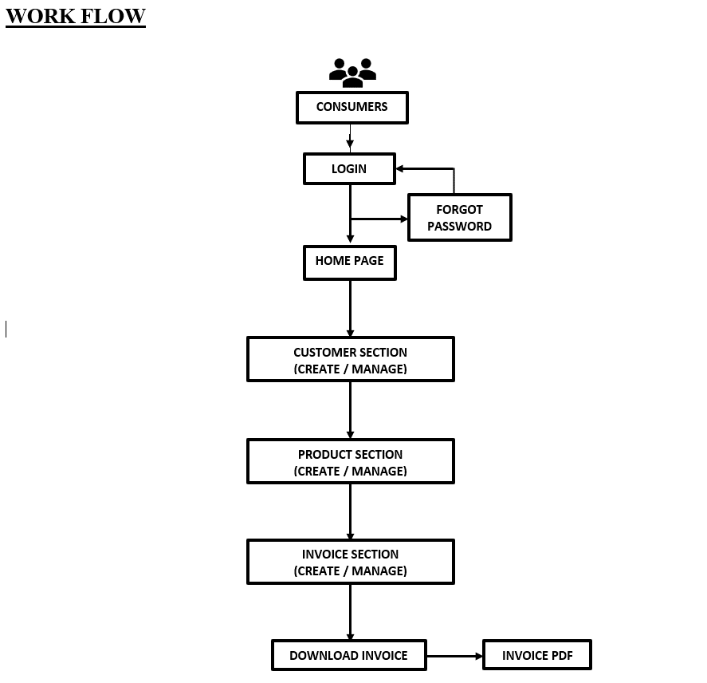
SYSTEM DESIGN

Slide 6
ARCHITECTURE OVERVIEW
The system follows a model-view-controller (MVC) architecture pattern for modularization and separation of concerns.
Presentation Layer: Implemented using JSP (Java Server Pages) for dynamic content rendering and HTML/CSS for frontend styling.
Business Logic Layer: Written in Java, encapsulating business rules and logic for invoice management, customer handling, and product tracking.
Data Access Layer: Utilizes JDBC (Java Database Connectivity) to interact with the MySQL database for CRUD operations on customer, product, and invoice data.

Slide 7
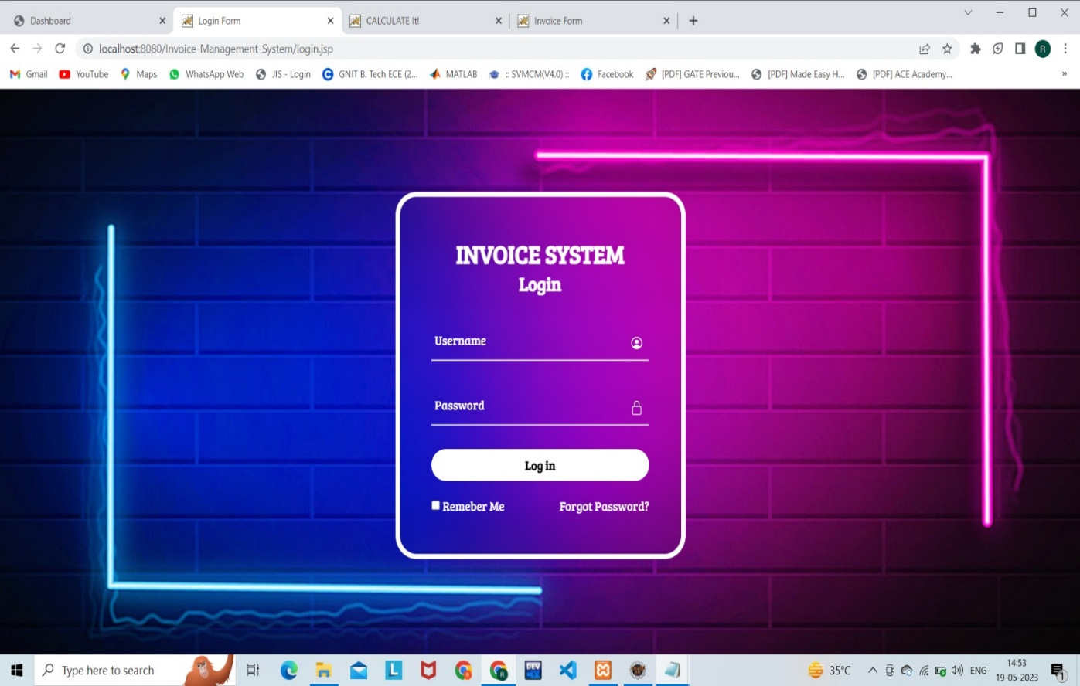
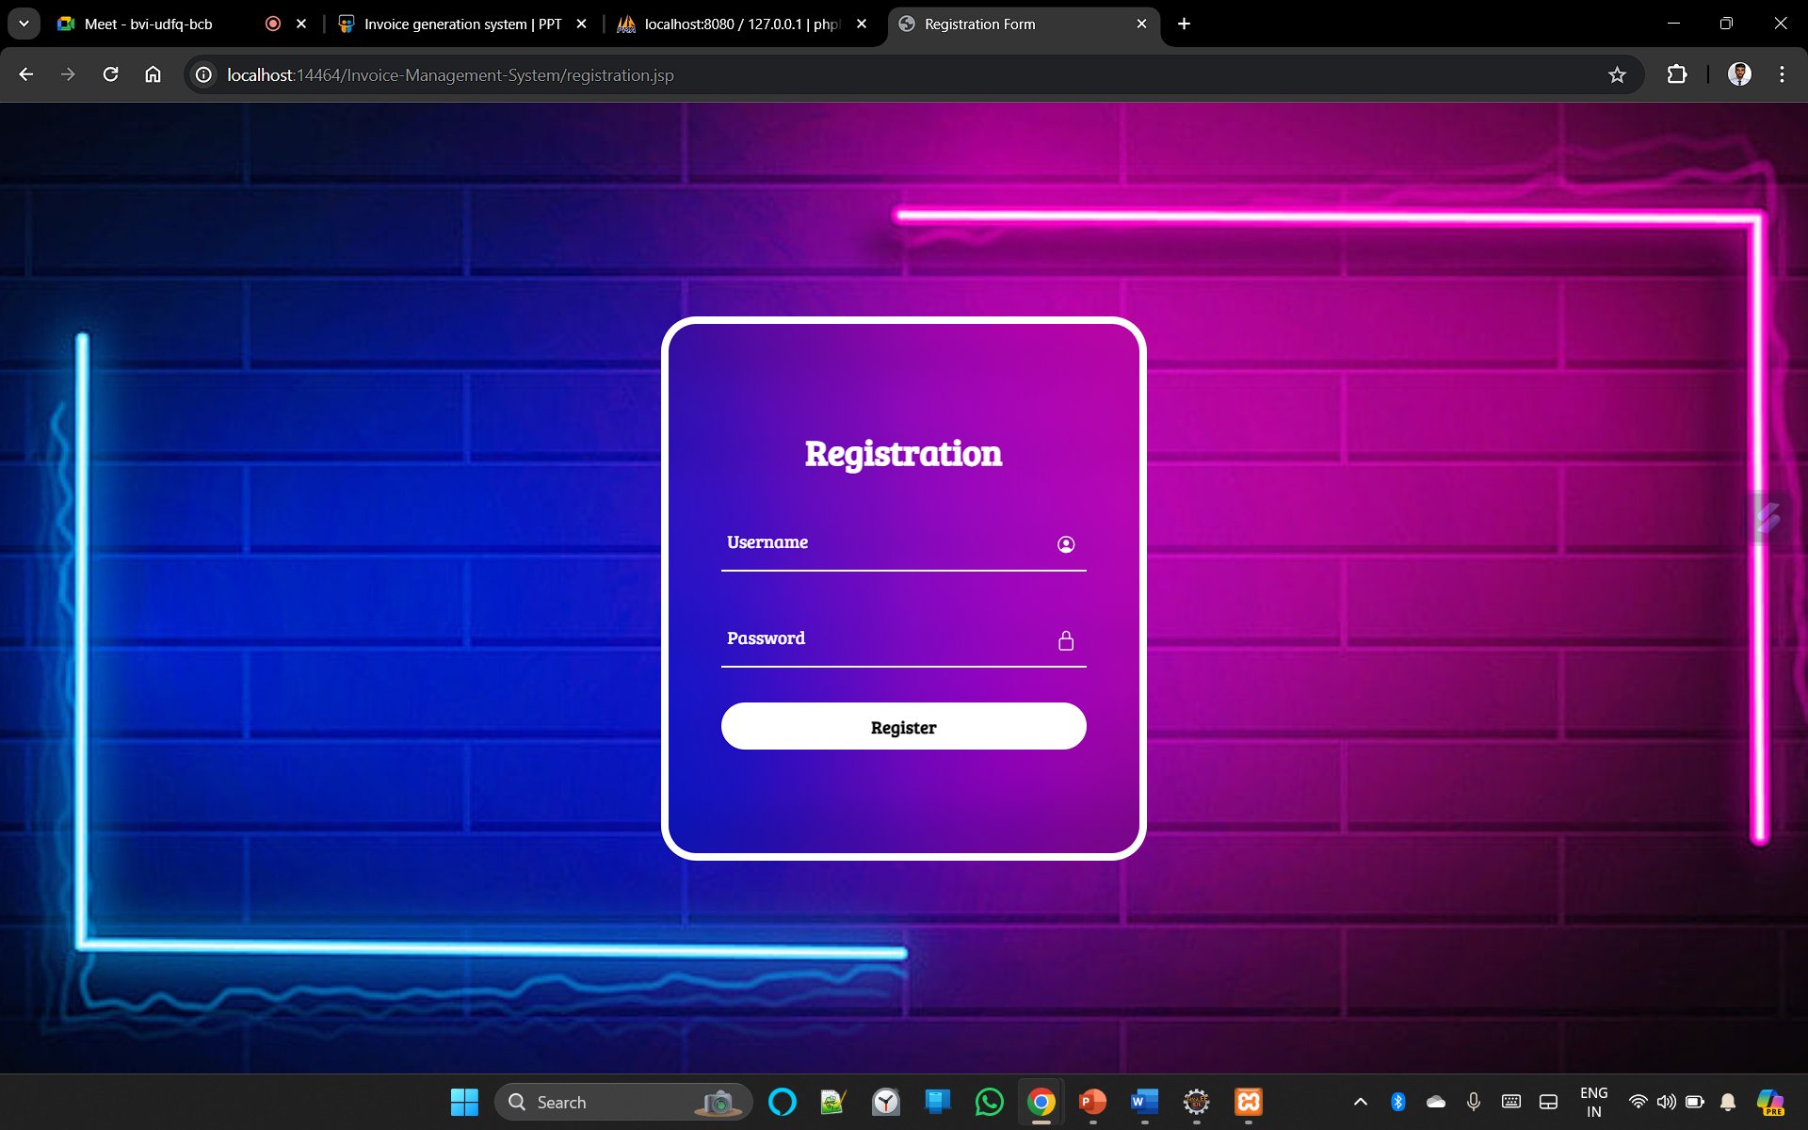
USER INTERFACE
AUTHENTICATION (LOGIN)
AUTHENTICATION (New Registration)

Slide 8
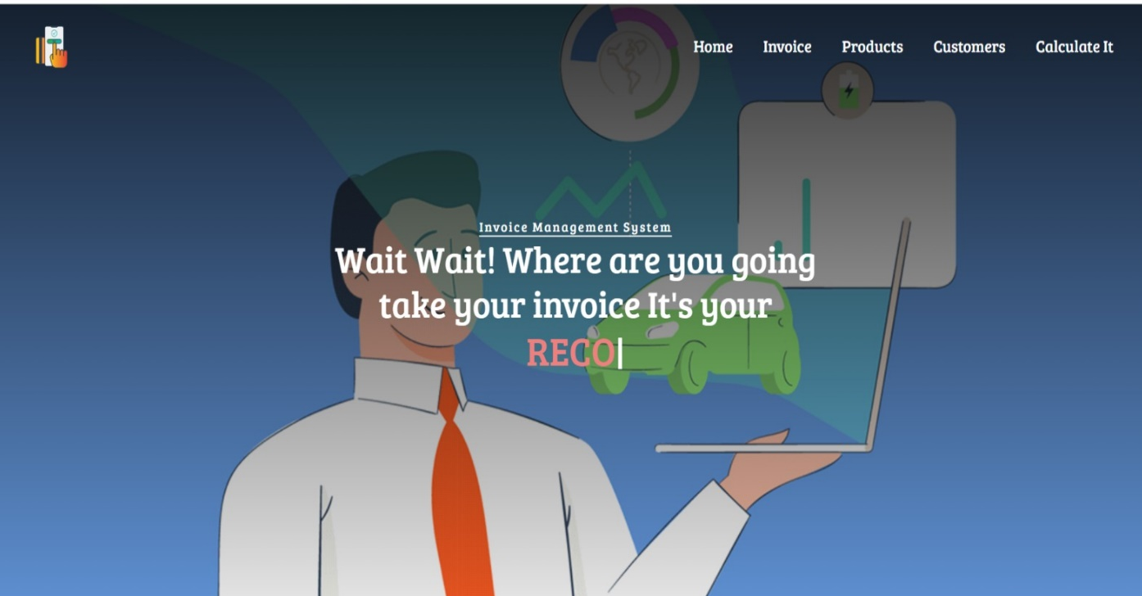
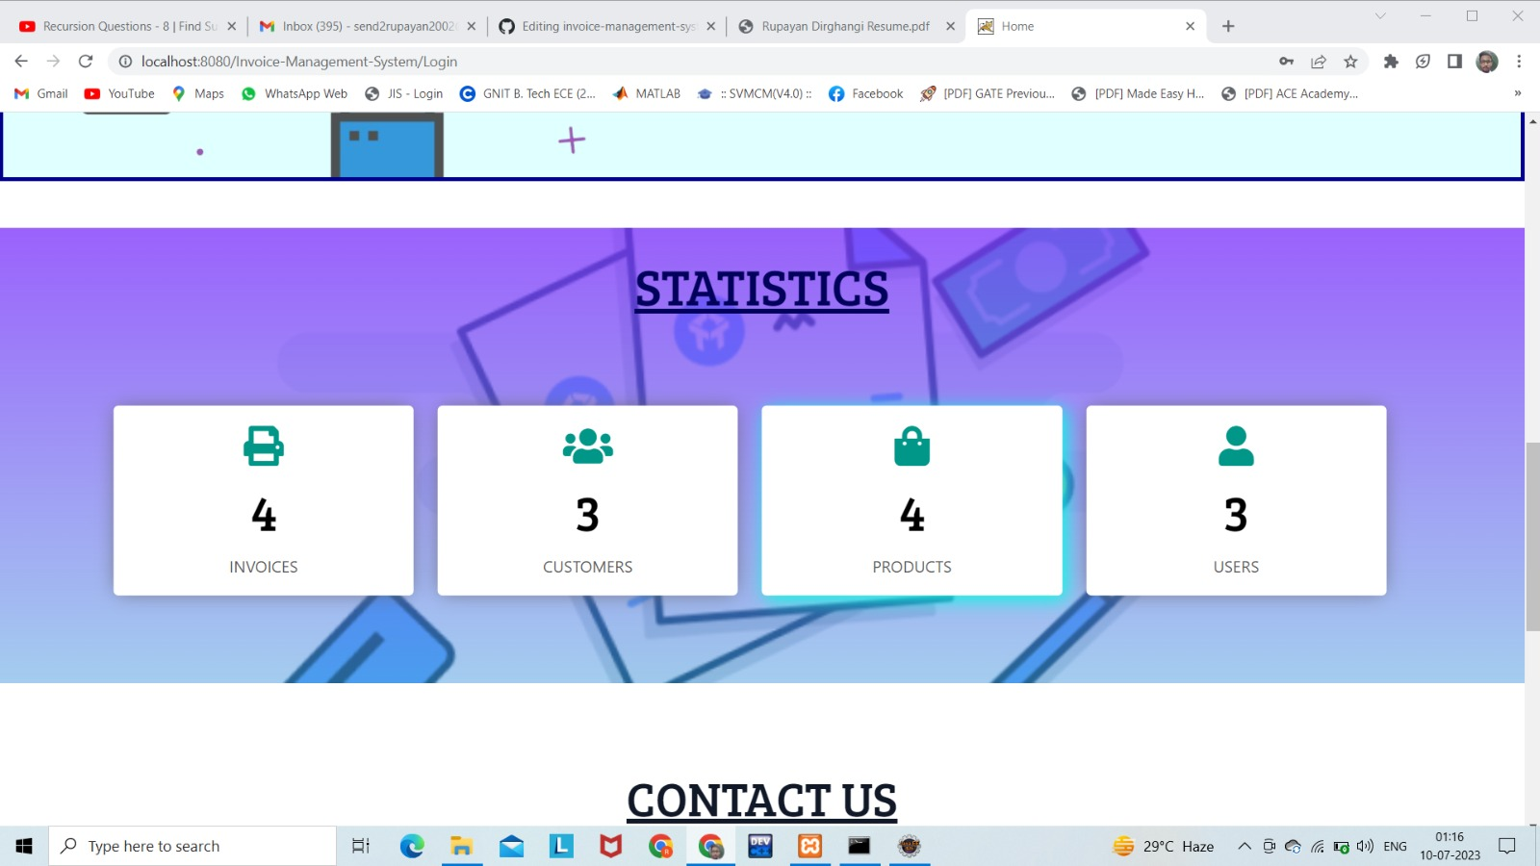
USER INTERFACE
HOME PAGE
STATISTICS

Slide 9
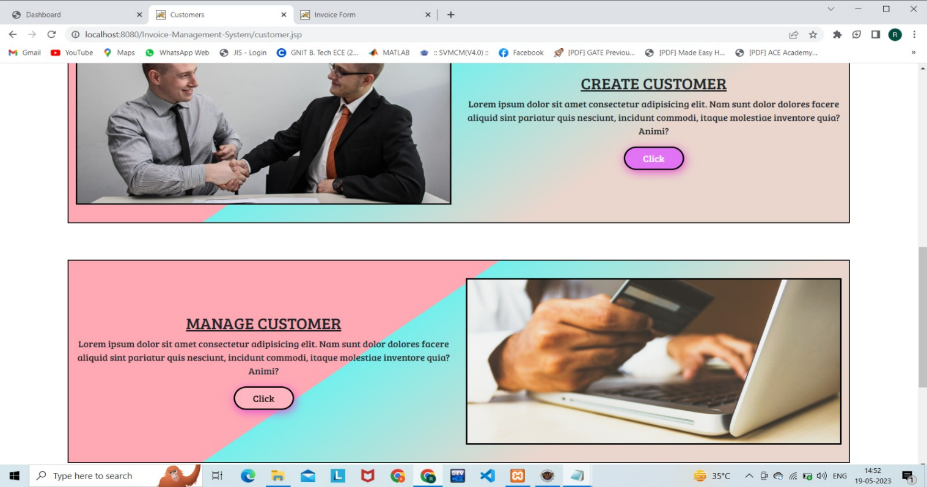
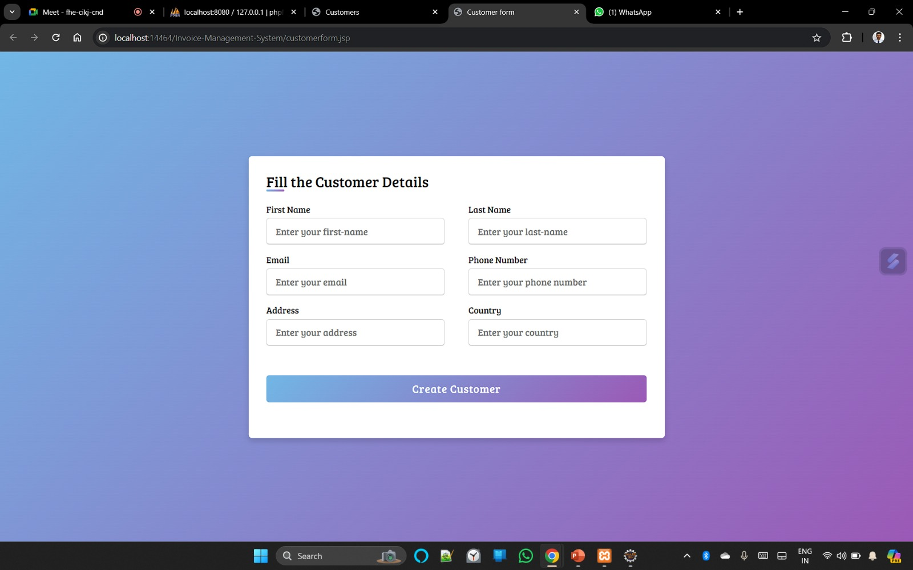
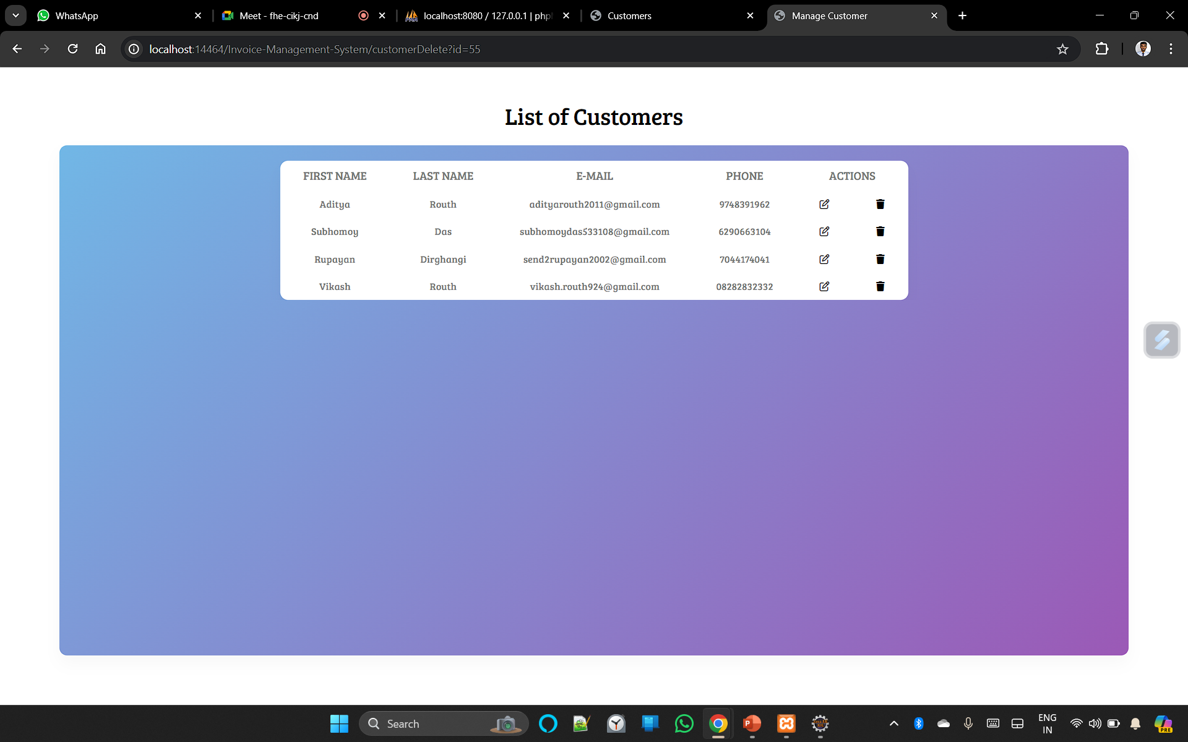
USER INTERFACE
CUSTOMER SECTION

Slide 10
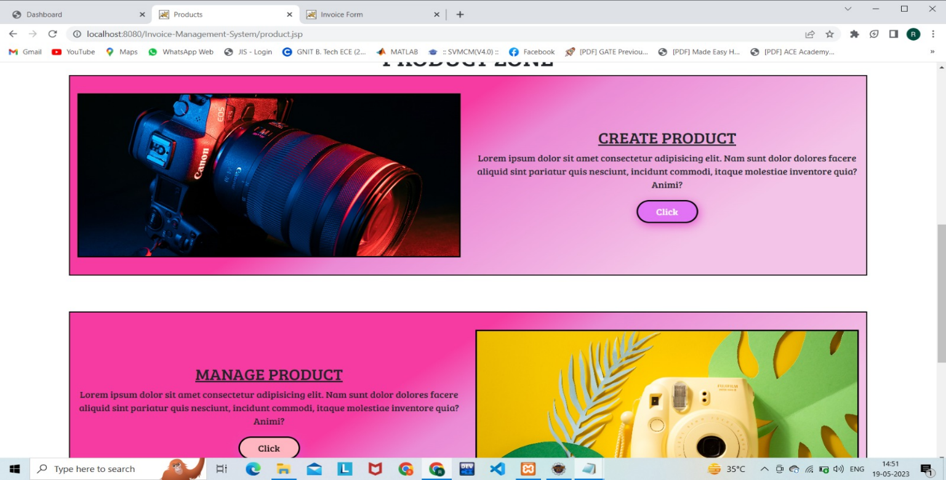
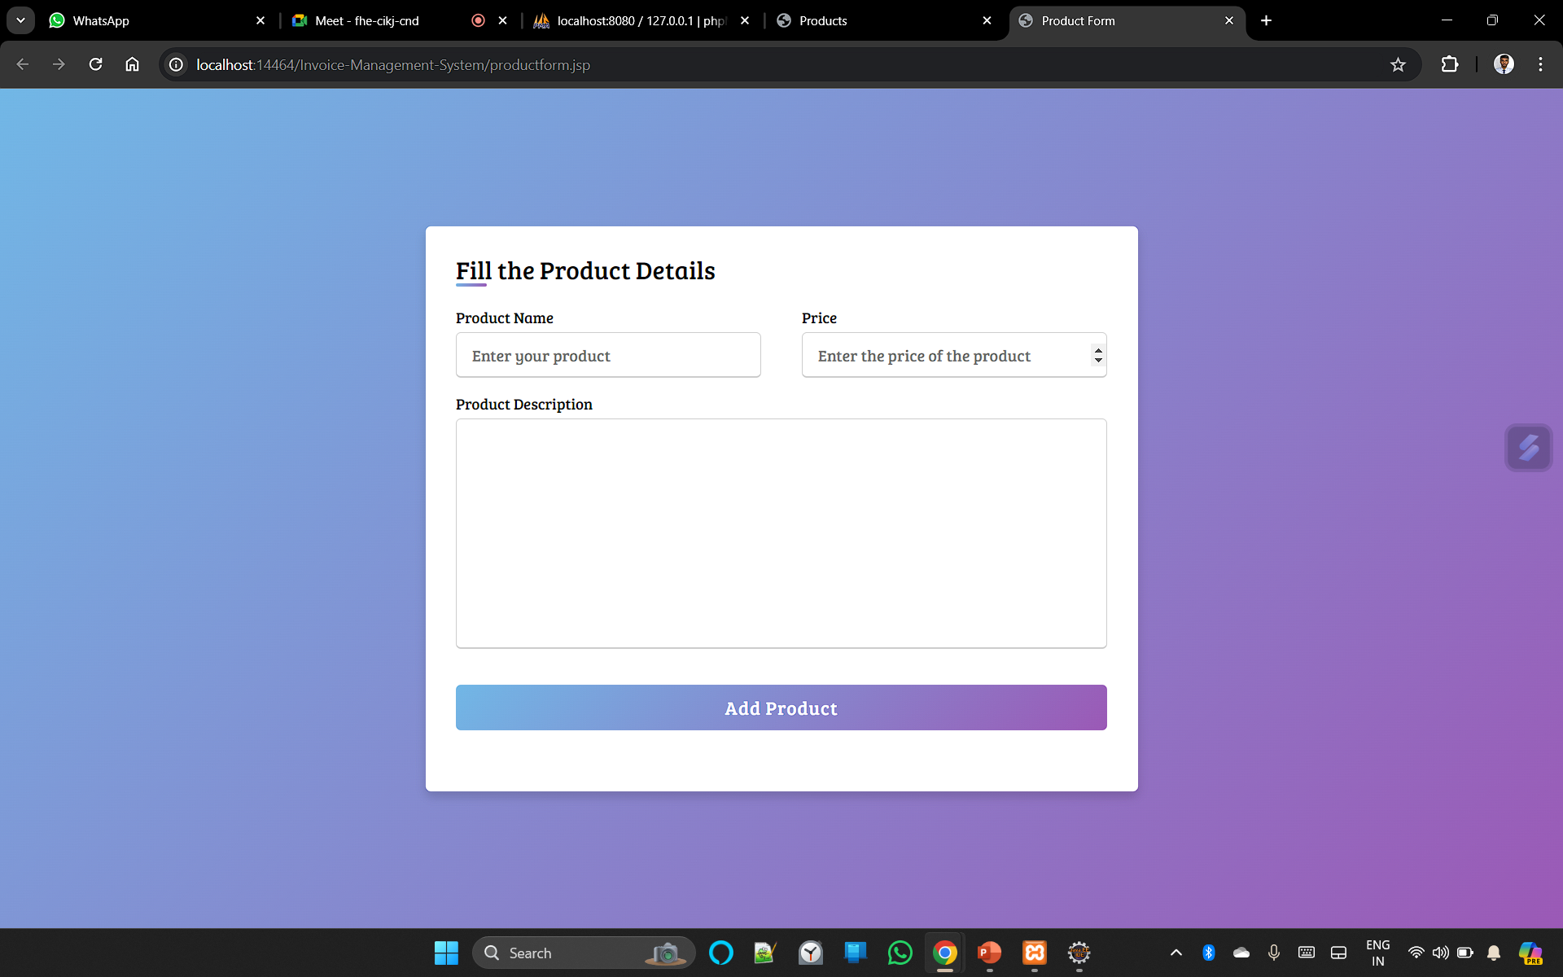
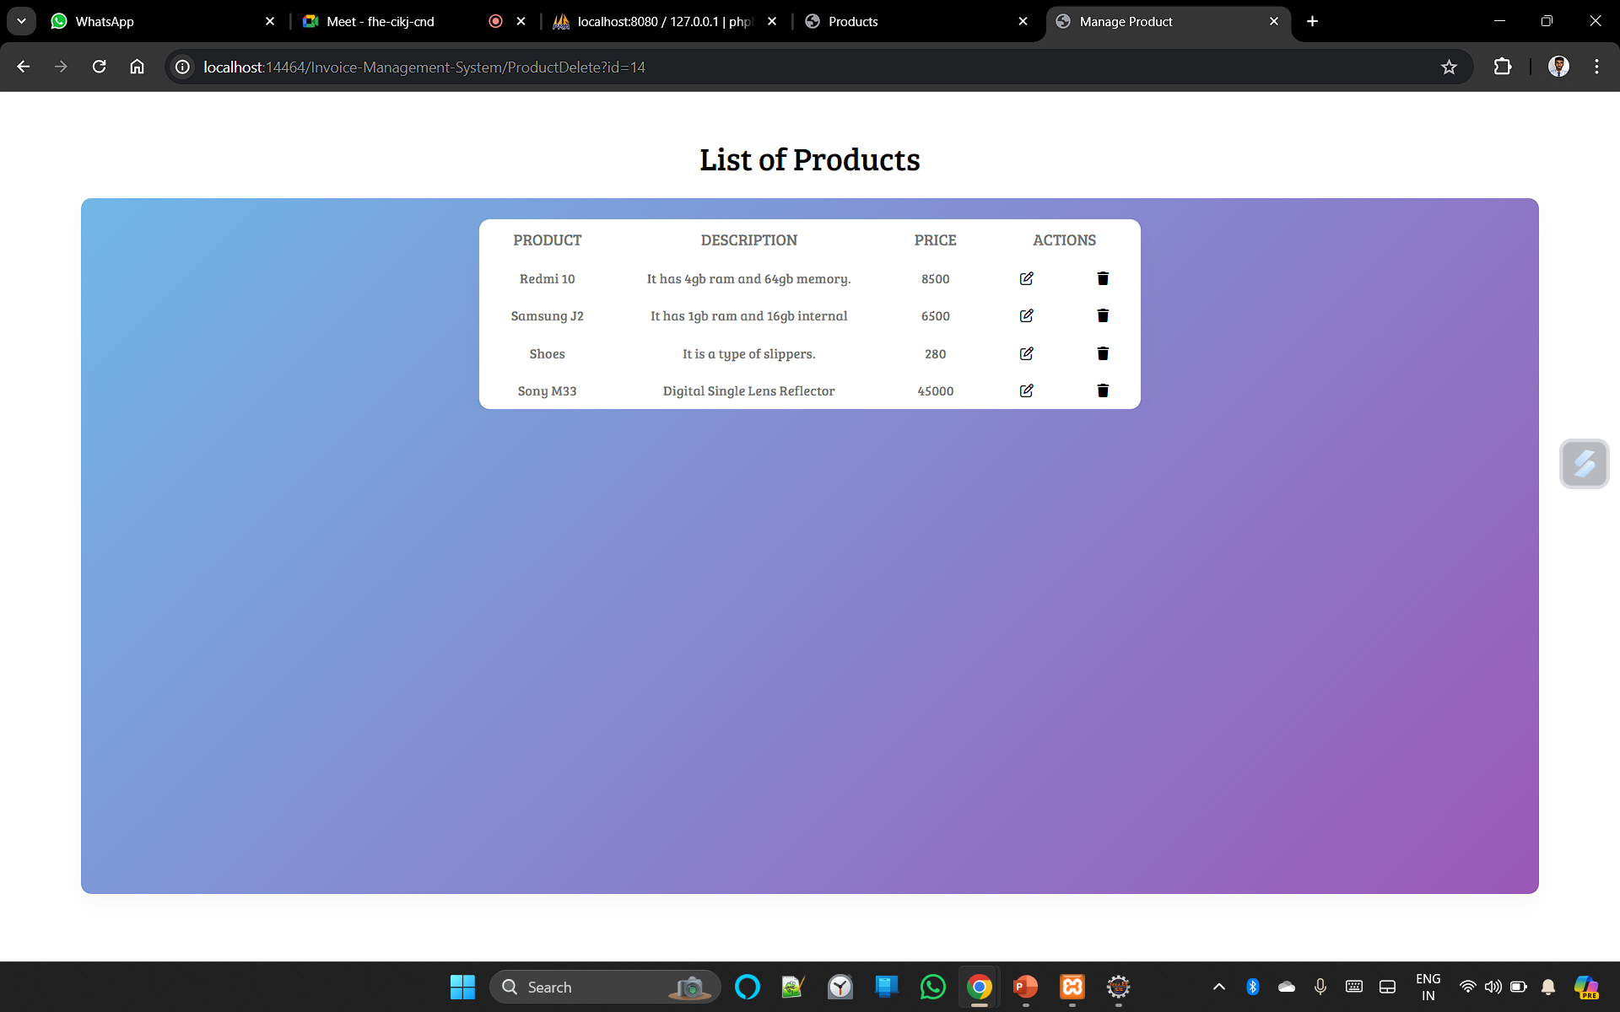
USER INTERFACE
PRODUCT SECTION

Slide 11
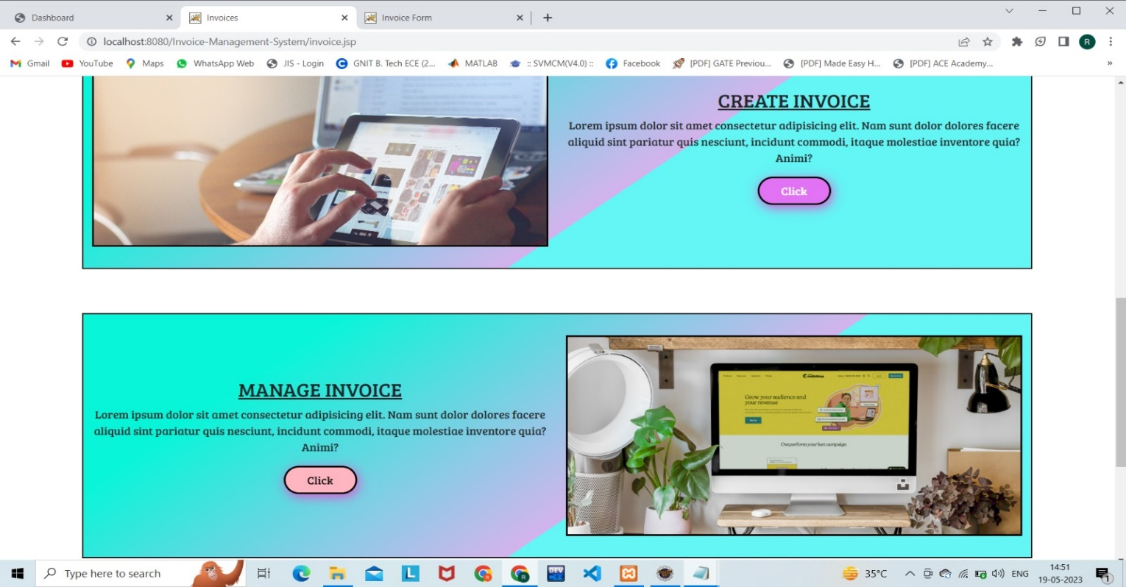
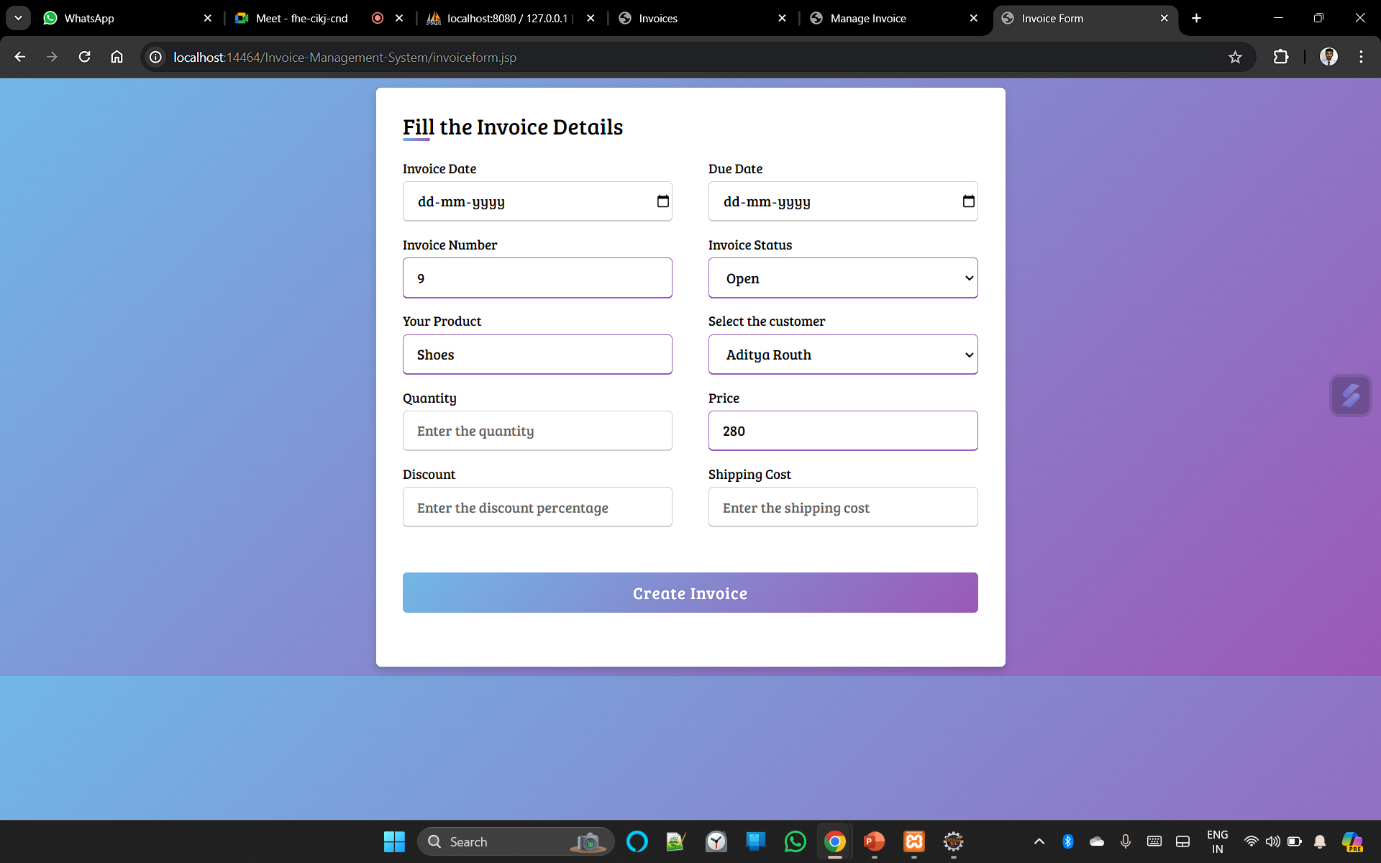
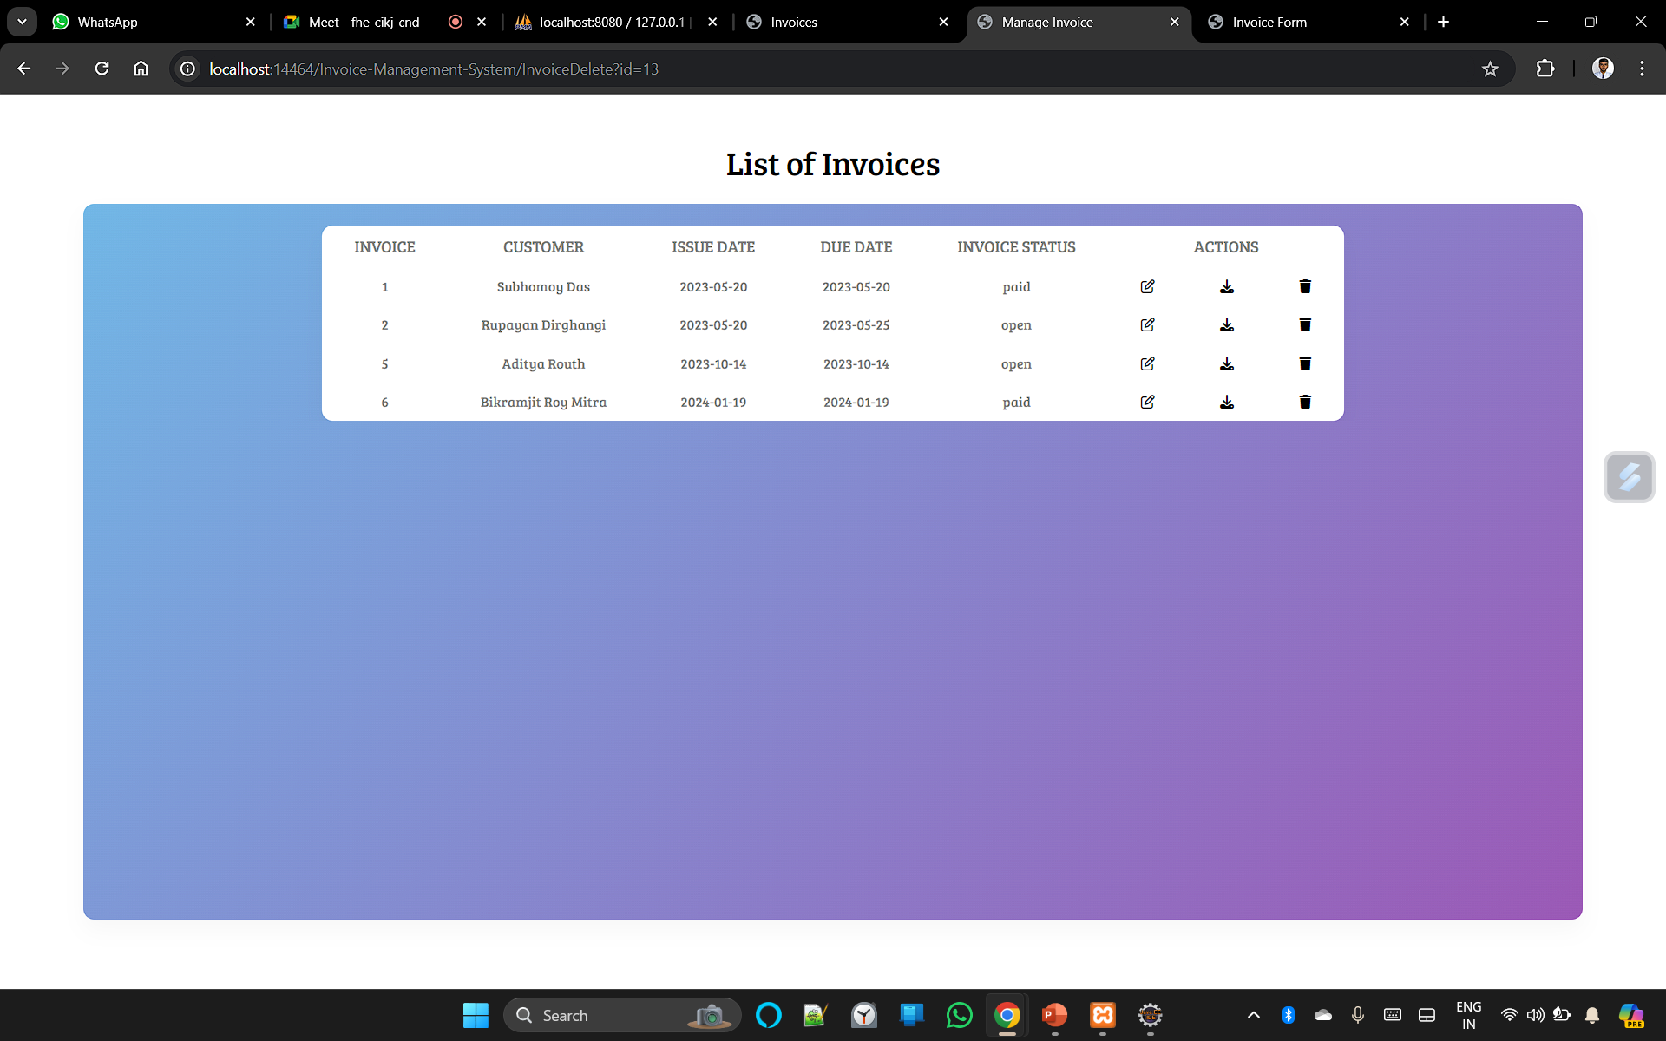
USER INTERFACE
INVOICE SECTION

Slide 12
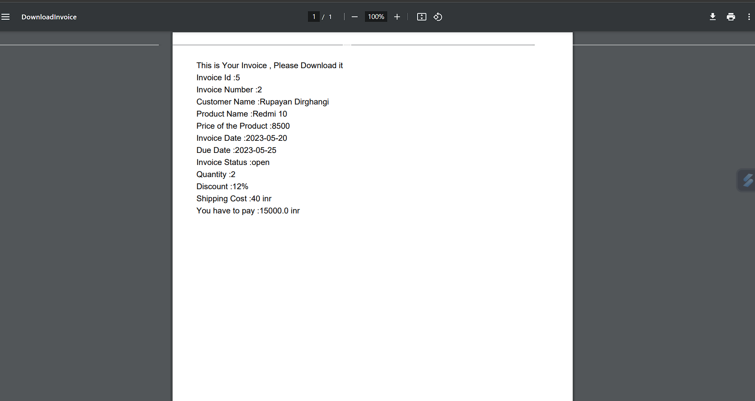
invoice Generated

Slide 13

FUTURE SCOPE
Mobile Application Development:
Develop a companion mobile application for the Invoice Management System portal, allowing administrators to access and manage invoices, customers, and products on-the-go.
Compliance and Security:
Focus on improving the user experience with intuitive interfaces, customization options, and easy integration with existing systems.
Automated Reminders and Notifications:
Implement automated reminder systems to notify administrators about upcoming invoice due dates, pending payments, or low stock levels for products.

Slide 14
CONCLUSION
The project “INVOICE MANAGEMENT SYSTEM” is for accessing invoices of the SYSTEM USERs through our website.
SYSTEM USERs can access their account and see/download invoice. End customers register online, login to account, and access their account using the website.
This application eliminates the need for a student to physically go to their institutes and collect their result or decreases the institute’s office duty

Slide 15



THANKS!!

